Slide 1
ARBEITSGEMEINSCHAFT FÜR DIE EINE WELT
Is a charitable organization and provider of non-profit welfare institutions.
Founded in 1974 by Christian volunteers, to care for foreign workers, refugees and people seeking apprenticeship seekers.
Today the AGDW e.V. employs an inter-culturally qualified team of approx. 38 employees who work
for refugees and migrants.
150-170 volunteers support our team in different areas.

Slide 2
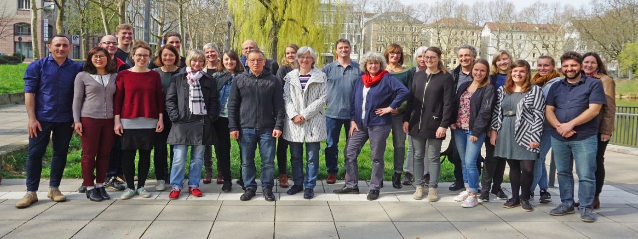
AGDW e.V. - Working community for one world
There are many resons for flight and migration:
political, ethnic or religous persecution
War and economic hardship
Evironmental degradation
Lack of prospects in the home country
The AGDW advises and looks after refugees in refugee shelters and assumes guardianship for unaccomponied minor refugees.

Slide 3
refugees-home management and
social services
ALMA VIVA
German courses
Migration advice for adult
immigrants (MBE)
network for the integration of
refugees in work (NIFA)
reboot – commitment to men who
have fled
Right to future II
repatriation counselling
Guardianship for underage
unaccompanied minors

Slide 4
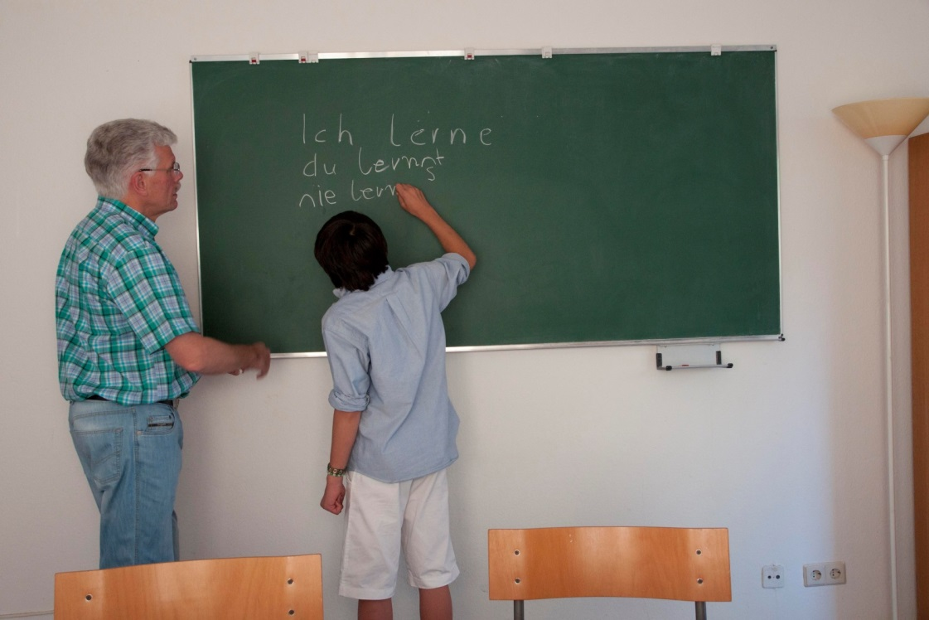
MefJu-
Mentors for youths
Project – Start: 2005
Projectname: MefJu - „Old helping the young “
Motto: „Dem Ingenör ist nichts zu schwör“
Desired goal: meeting at eye level between people with and without
an immigration background

Slide 5
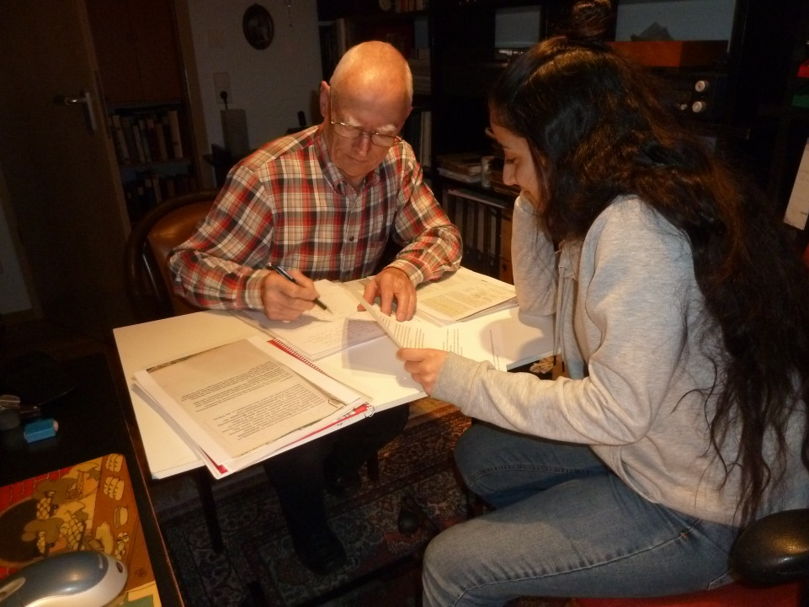
Mentors for youth (MEFJU)
36 children and adolescents
(21 boys/ 15 girls, 8-25 Jahre alt)
from families in difficult living conditions
38 mentors provided guidance, help,support:
In individual school subjects - elementary to high schools,
In the preparation of degree courses and training,
In application situations,
During the transition from school to work,
In apprenticeships/ vocational schools,
In everyday life,
common activities such as excursions, visits
museum/ library/ youth theater etc. were
gladly undertaken by some tandems.
The Project MefJu is funded by the regional capital Stuttgart .

Slide 6
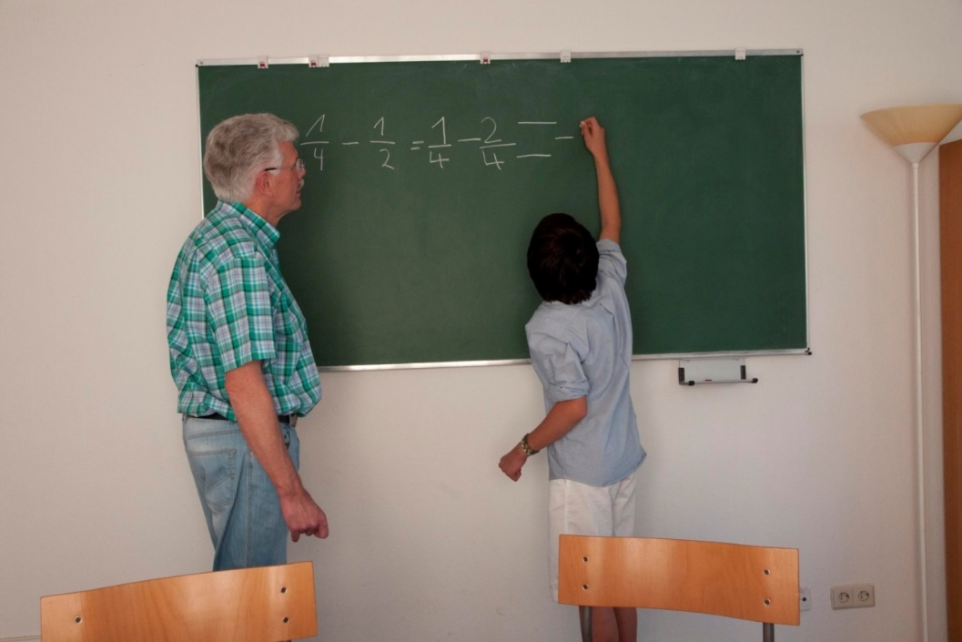
„To make a child strong, it takes a whole village“(African adage)
Mentors are:
Companions,
Impulse generators
Supporters
Sponsors
Mentors are:
Interested lay-people with a big heart and experiences
Mentors bring:
Knowledge, experience, care, reliability

Slide 7
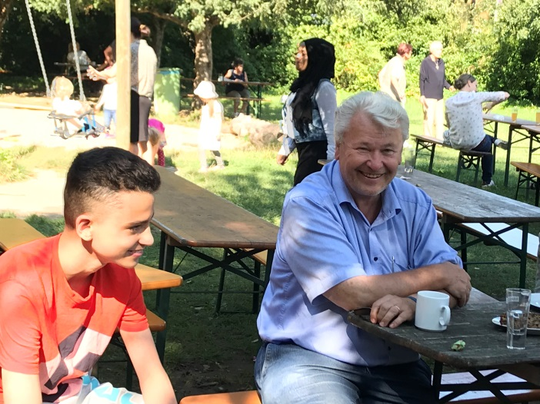
Sponsorship have a long-term and prevent effect,
adults strengthen children/ families as role models and give concrete attention,
Mentors willingly choose to work responsibly and reliably,
Their commitment must be personal,
They must be capable of offering the assistance,
their support must be beneficial for the recipients
Mentors are not service providers,
they are not babysitters,
they are not exclusively tutors,
they are not family-friendly helpers with a professional detachment.
They cannot replace professional help

Slide 8
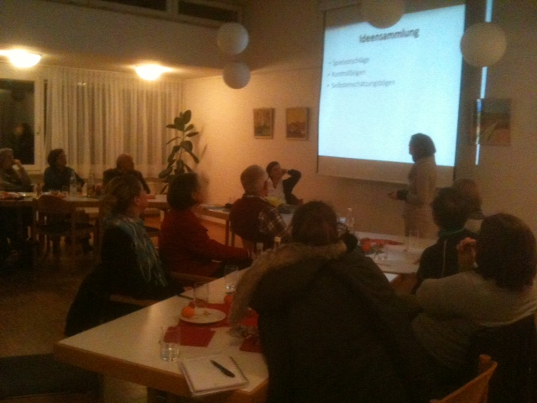
Quality standards:
Public relations
Selections of mentors
Admission of children/ adolescents/ families
Matching and start
Mentors support
Supporting the children/ adolescents/ families

Slide 9
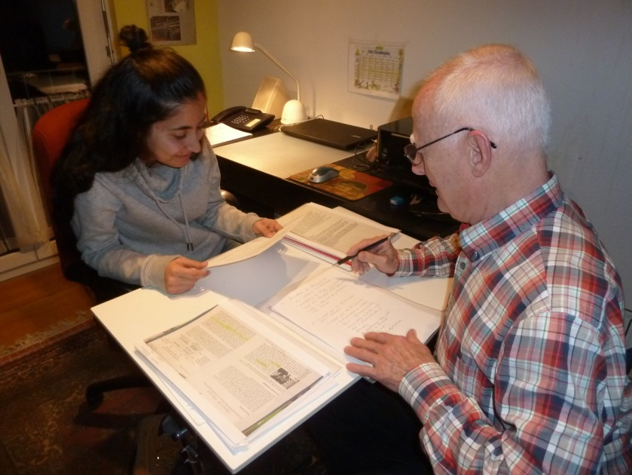
A mentor‘s experience:
Being with a mentee is a permanent challenge that I gladly accepted in order to ascertain how integration can work. What started as a casual tutoring has now been replaced with a ‚learning process‘ which takes me back to my 11th grade in grammar school, where the fear of the next class exam prevails…
However, the joy is greater, when we later see a grade 2 at the bottom of Zeynabs exam paper.
Dr. H. Hechler
„Es gibt mir Kraft und Geduld, wenn ich sehe, wie mein Mentor sich für meine Zukunft Mühe gibt und wie sehr er sich freut, wenn ich erfolgreich bin“. Zeynab

Slide 10
The volunteer in the MefJu program
stands for trusting cooperation
multual appreciation
arouses interest in the cultural an social life
in the German language
in literature
helps to acquire self-confidence and self-
assurance
to break down prejudices and
stereotypes
to gain a new/ different understanding
of the each other

Slide 11
„All men are born free and equal in dignity and rights.“
There are laws with which rights can be demanded. But to respect and preserve the dignity of others is just as much a moral claim in our daily lives.
Ariane Müller-Ressing
CEO AGDW e.V. in the Annual Report 2018

Slide 12
Thank you very much for listening!

