Slide 1
Senior Volunteers for Migrant Integration No. 2017-1-LT01-KA204-035213
Overview of the project results
Gileta Kierienė
Project coordinator

Slide 2
Methodology, 20 hour training programme and material for senior volunteers providing support for migrant and refugee integration
Social and civic integration tool – guide for migrants and refugees in App format

Slide 3
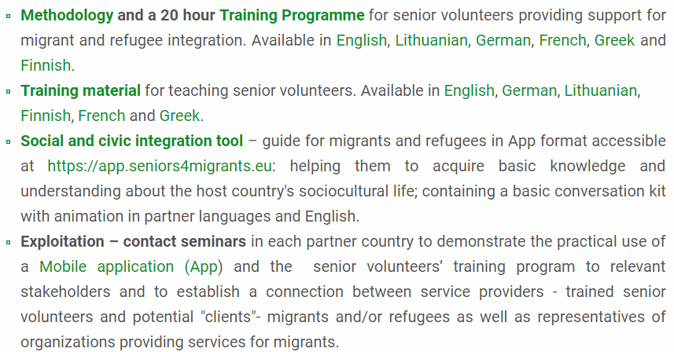
Accessible from the project website at www.seniors4migrants.eu/en/projects-results

Slide 4
Aims to prepare seniors willing to serve as volunteers to support migrants in their integration process into a new host society.
Consists of recommended content that could be used by trainers or any other educators involved in adult training.
Can be used in many different ways:
in its entirety as it is – the whole training programme,
each module can be used separately, reduced or supplemented according to the specific country’s needs or the needs of institutions, trainers, and trainees.

Slide 5
Trainers and adult educators wishing to train seniors to serve as volunteers in migration and refugee integration.
Trainers are free to select the content most suitable for the training needs of their specific learners.
After the training, seniors, using their life and professional experience, can volunteer in many areas of migrant integration, such as:
host country language training,
translation,
education,
health-care,
legal services consulting,
they may work as civics and literacy tutors, mediators and advocates, or facilitators in other areas – depending on their professional experience and expertise, as well as their aspirations.

Slide 6
The SVMI training programme and the teaching material consists of five modules:
Module 1 | Key elements of adult educator's competences
Module 2 | Key elements of intercultural communication competence
Module 3 | Migrants integration: overview of theoretical models
Module 4 | Introduction to active citizenship; key roles of a volunteer working for migrants and refugees’ integration
Module 5 | Country specific material providing important cultural aspects and tips of SVMI partner countries cultures

Slide 7
The first four modules are available in English and five partner country languages (German, Greek, Finnish, French, and Lithuanian) and contain the same information adapted to national contexts.
The fifth module is developed by each partner following specifics of that country and is available only in the language of that particular country. It provides tailor-made material for the specific needs of that country’s volunteers who wish to participate in migrant integration.

Slide 8
The training programme is 20 hours long – 5 modules, each 4 hours long.
The training content is purely of a recommendatory nature. It can be used as a whole training programme or any module can be used separately.
According to trainees’ needs, the length of each module can be adjusted.
In addition, trainers are free to use their own materials, exercises, or links.

Slide 9
The SVMI training programme is not limited to senior training – it can be used in other fields and contexts where such training is required.
Potential beneficiaries of this programme could be: educators from formal and nonformal adult education institutions, institutions working with migrants, NGOs, and even college and high school teachers, who may take parts of the training material or incorporate single modules into their teaching process.

Slide 10
The SVMI training programme and the teaching material consists of five modules:
Module 1 | Key elements of adult educator's competences
Module 2 | Key elements of intercultural communication competence
Module 3 | Migrants integration: overview of theoretical models
Module 4 | Introduction to active citizenship; key roles of a volunteer working for migrants and refugees’ integration
Module 5 | Country specific material providing important cultural aspects and tips of SVMI partner countries cultures

Slide 11
Key elements of adult educator's competences
This module is addressed to senior volunteers, who so far have not received specialized training on adult education in general and more specifically, on migrants and refugees training.
The module presents the principles and theories of adult learning, the characteristics of the adult learner, the motivation of adult learners and effective techniques for leading and managing the adult classroom.

Slide 12
Learning outcomes
At the end of this module, learners will be able to:
Understand the differences between andragogy and pedagogy;
Demonstrate an understanding of some of the more common characteristics of adult learners;
Relate principles of effective adult education to what is known about how adults learn best;
Demonstrate a basic understanding of common theories of what motivates adult learners to participate and learn in adult education;
Describe typical barriers to participation and learning in adult education;
Outline basic theories and types of learning;
Get an understanding on teaching methods and techniques that encourage adult learning.

Slide 13
suggested structure
Introduction – 20 min
Unit 1: ANDRAGOGY – THE ADULT LEARNING THEORY – 50 min
Unit 2: ADULT LEARNERS’ CHARACTERISTICS – 50 min
Unit 3: MOTIVATING ADULT LEARNERS – 50 min
Unit 4: LEARNING METHODS AND FORMS – 50 min
Unit 5: CONCLUSION: 20 min
Overall duration: up to 4 hours

Slide 14
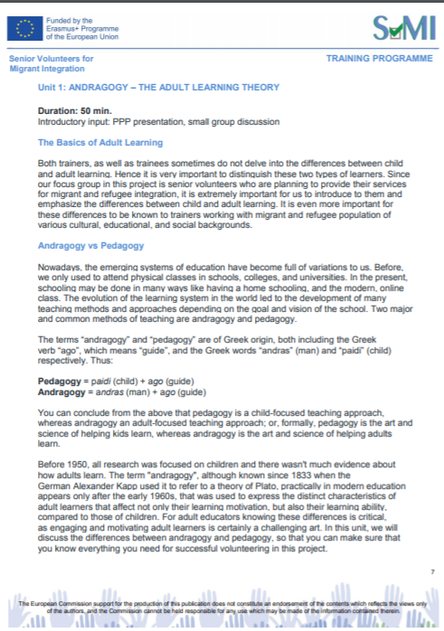
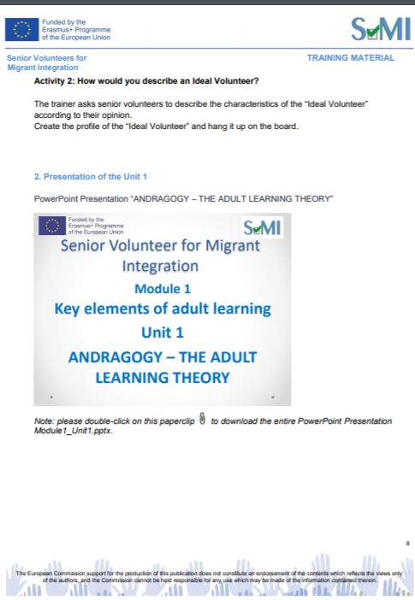

Slide 15
Accessible from the project website at www.seniors4migrants.eu/en/projects-results

Slide 16
– guide for migrants and refugees in App format:
helping them to acquire basic knowledge and understanding about host country’s – Lithuania, Germany, Greece, Finland and France - sociocultural life
containing survival conversation kit in English and partner languages (LT, DE, GR, FI, FR)
available for free download at https://app.seniors4migrants.eu

Slide 17
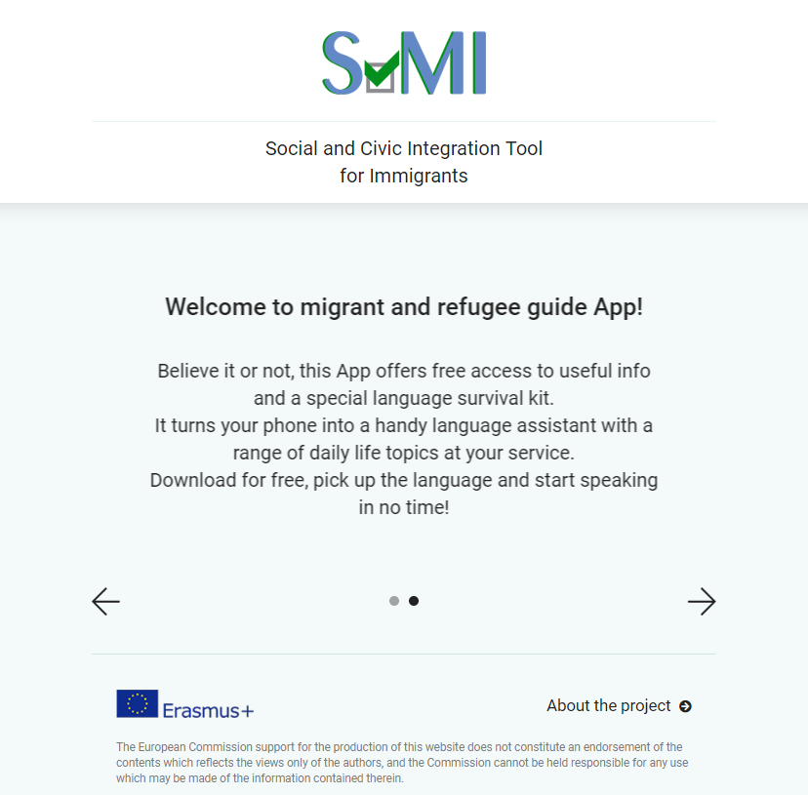

Slide 18
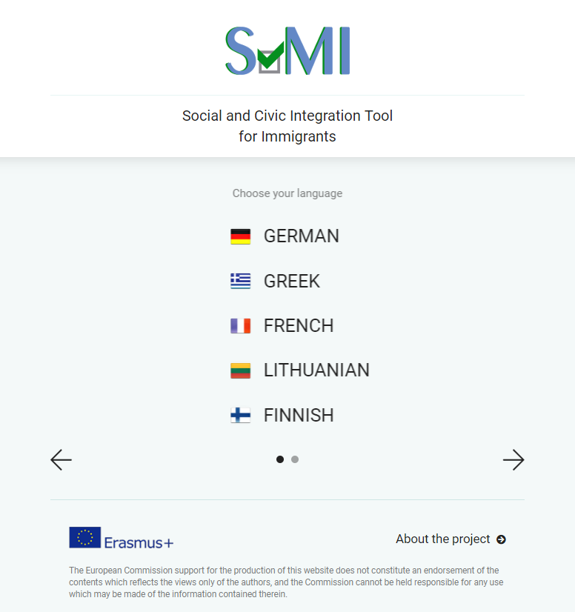
Notes:
Choose the language and get to the categories ...

Slide 19
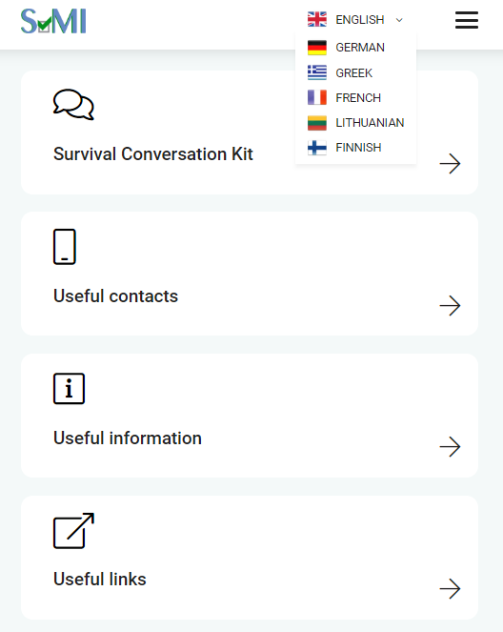
Notes:
Go to USEFUL INFO...

Slide 20
Notes:
In this section we provide the following information for each partner country...

Slide 21
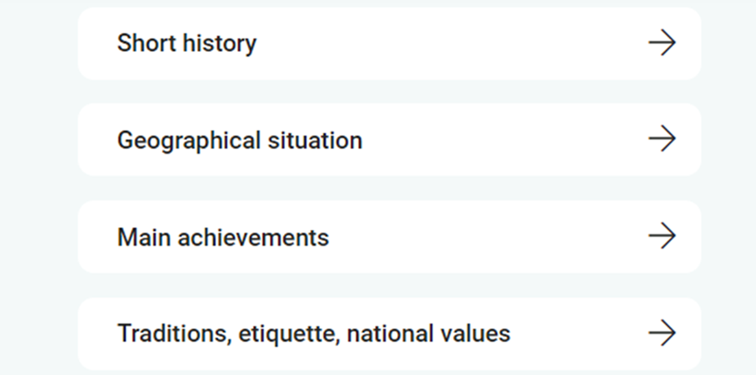
About the country | Apie šalį | Über das Land
Σχετικά με τη χώρα | À propos du pays | Tietoja maasta
Notes:
Information on each country is provided in English, Links to the websites in partner languages
Go back to the categories...

Slide 22
Notes:
Choose USEFUL CONTACTS

Slide 23
Useful contacts| Naudingi kontaktai| Nützliche Kontakte
χρήσιμες επαφές| Contacts utiles | Hyödyllisiä yhteystietoja
Immigration office
Migrant community centers, NGOs
Health care services, hospitals
Language learning institutions
https://app.seniors4migrants.eu/lt/contacts
https://app.seniors4migrants.eu/de/contacts
https://app.seniors4migrants.eu/fr/contacts
https://app.seniors4migrants.eu/gr/contacts
https://app.seniors4migrants.eu/fi/contacts
Notes:
In this section we provide the most important contacts in partner countries, such as: immigration office, etc.
If you‘d like to try now on your smartphones, please use the following links

Slide 24
Useful links| Naudingi šaltiniai| Nützliche Links
χρήσιμοι σύνδεσμοι | Liens utiles | Hyödyllisiä linkkejä
Main laws/ requirements
Public services relevant to migrants
Useful tips
Links to language resources
Links to relevant projects
https://app.seniors4migrants.eu/lt/links
https://app.seniors4migrants.eu/de/links
https://app.seniors4migrants.eu/fr/links
https://app.seniors4migrants.eu/gr/links
https://app.seniors4migrants.eu/fi/links
Notes:
In this section we provide links to the most important resources, such as: main laws, etc.
If you‘d like to try now on your smartphones, please use the following links.
Now we proceed to the most important category...

Slide 25
SURVIVAL CONVERSATION KIT
Svarbiausių dialogų rinkinys |Kit de conversation de survie|
Suomea aloittelijalle | Überlebenspaket für Alltagsgespräche |
οδηγός καθημερινής επικοινωνίας
contains a basic conversation kit with animation in partner languages and English
https://app.seniors4migrants.eu/lt/survivalkit
Notes:
Lets go inside...

Slide 26
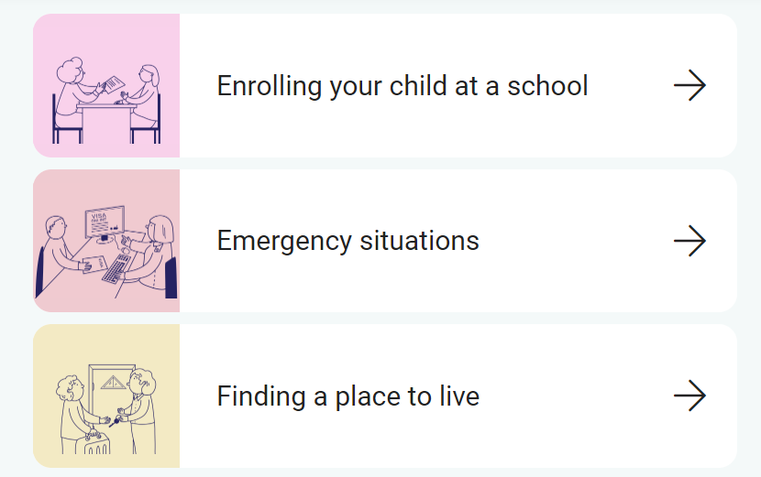
Notes:
It contains dialogs on these key topics: frst 3 in this slide and the rest in the following

Slide 27
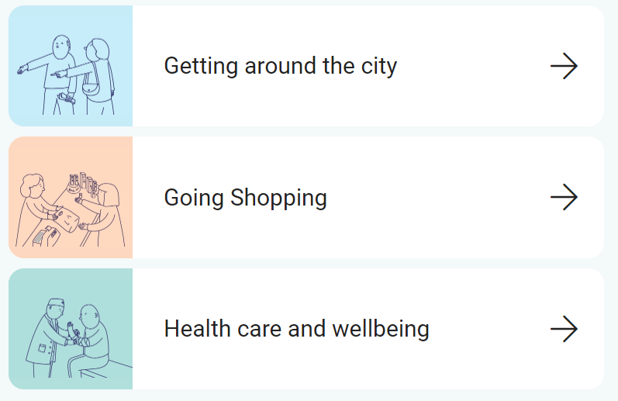
Notes:
Now let‘s try to use it...

Slide 28
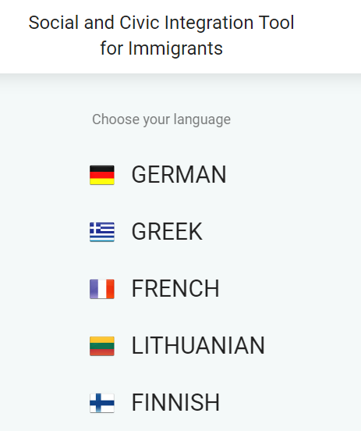
Survival conversation kit: How to use it?
Go to https://app.seniors4migrants.eu
Select the language
Notes:
Let‘s start from Lithuanian.

Slide 29
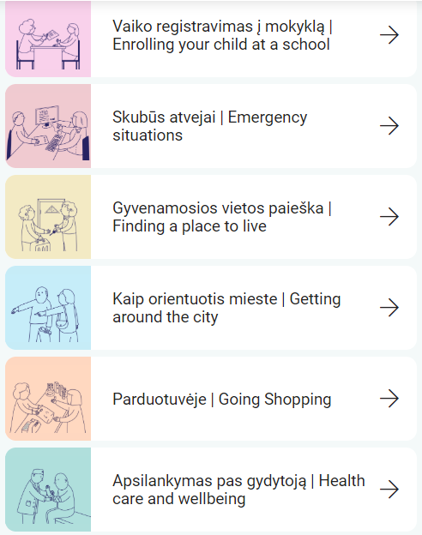
3. Select the category
https://app.seniors4migrants.eu/lt/survivalkit
Notes:
We select the most vital – health care and wellbeing

Slide 30
4. Example: Health care and wellbeing
https://app.seniors4migrants.eu/lt/survivalkit/health_care_and_wellbeing/6?comment=2

Slide 31
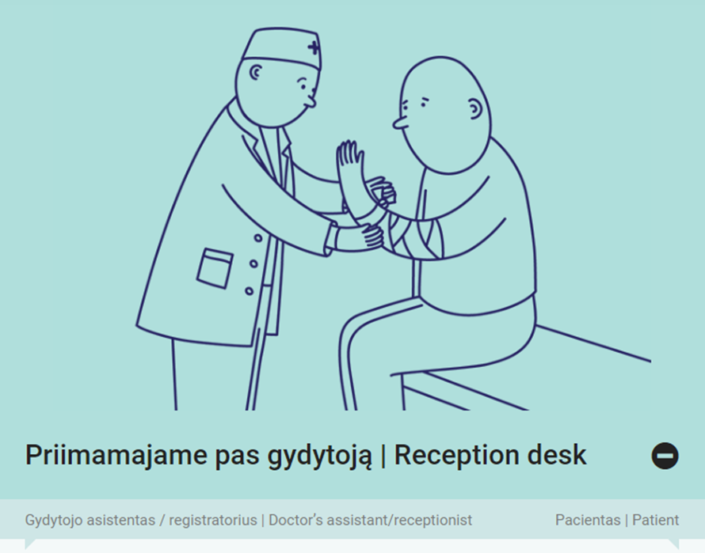
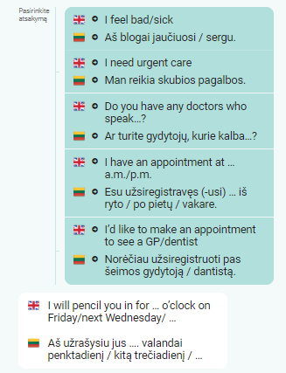
Notes:
We see some most likely dialogues at a reception desk, such as...

Slide 32
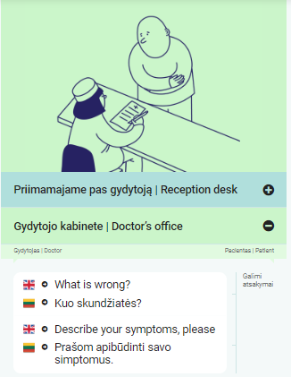
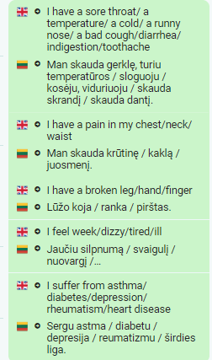
Notes:
And here are the dialogues that will be useful in the doctor‘s office

Slide 33
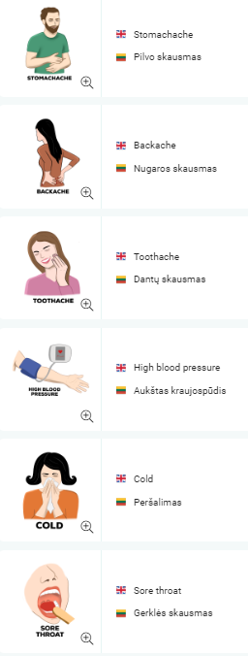
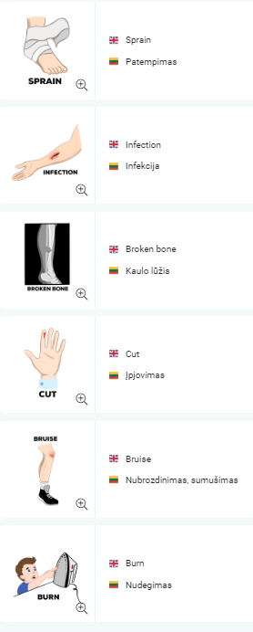
Vocabulary
Notes:
... And of course some related vocabulary

Slide 34
Go to https://app.seniors4migrants.eu
Select the language
Notes:
Now let's see how it works with a language we don't know. Let‘s try it in Greek! I’d like to invite here our guest from Athens, Mrs Mariya Konchak, representative of Equal Society, Greece. She will help us☺

Slide 35
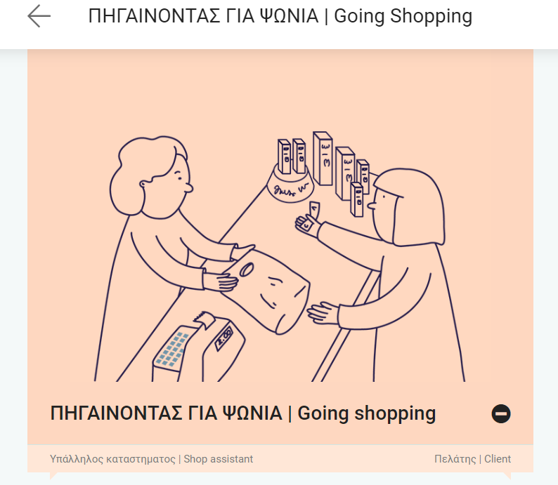
Select the category:
Notes:
Ms Mariya, could you please read it?

Slide 36
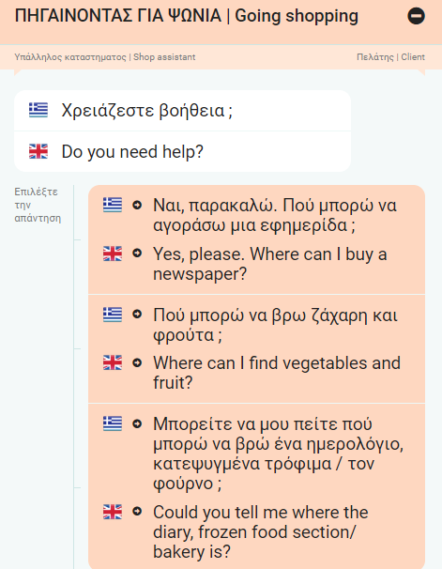
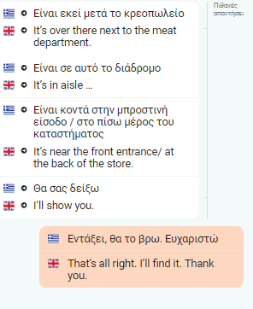
Notes:
Here we see dialogues that we could use talking to the shop assistant. Interesting, how it sounds in Greek> Ms Mariya, could you please read it?

Slide 37
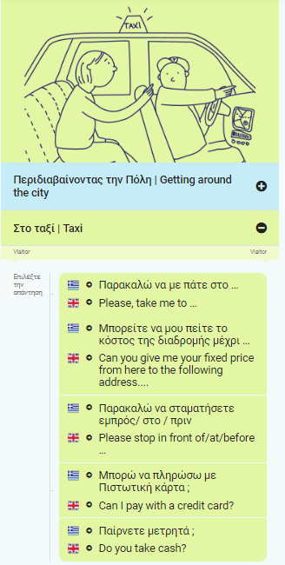
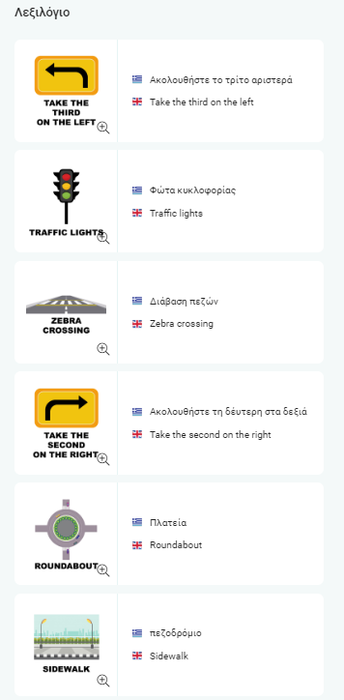
Notes:
And some more vocabulary that would help you during your trip to Greece: some useful phrases while taking a taxi. Hopefully it will help you have a great vacation☺

Slide 38
