Slide 1
EPALE –
Electronic Platform
for Adult Learning in Europe
http://ec.europa.eu/epale/
Dr. Edita Trečiokienė
Vilnius, September 12, 2019

Slide 2
Make use of EPALE for:
Preparing your application
Managing your project
Sharing your experiences and results

Slide 3
This is what you see when you enter the platform

Slide 4
Preparing your application
Make use of experiences from others!
Search for (application) supporting documents!
Check that you mean the same when using for instance
an English term

Slide 5
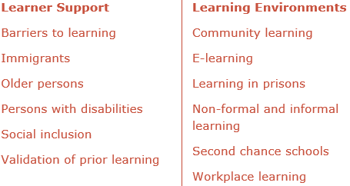
Preparing your application – find themes that hit your project idea

Slide 6
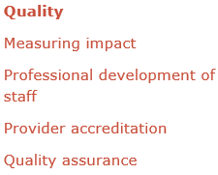
Preparing your application – find themes that hit your project idea

Slide 7
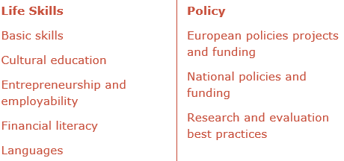
Preparing your application – find themes that hit your project idea

Slide 8
Sharing your experiences and results- during and after the project period
Write blogs!
Link to resources ( results, reports …)!

Slide 9
Sharing your experiences and results - during and after the project period
Promote courses and events organised by your projects
country
language of the event
theme
date
target group
type of event

Slide 10
Share and promote your ideas makes you more visible in your field

Slide 11
Education Exchanges Support Foundation
Rožių al. 2, 03106 Vilnius,
Lithuania
Email EPALE@smpf.lt

